Slide 1

Strings

Slide 2
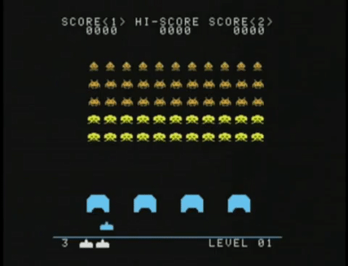
Final Project Example
Take a deep breath…
🤔

Slide 3
Final Project Example
public class SpaceInvaders extends GraphicsProgram {
private ArrayList<GOval> aliens;
private GRect paddle;
public void run() {
// create objects and scores // add() to canvas
setupGame();
while(!gameOver()) {
animateObjects();
pause(100);
}
}
private boolean keyPressed() {...}
private boolean mousePressed() {...}
}
Setup
Animate
Interact
Start with a high-level look.

Slide 4
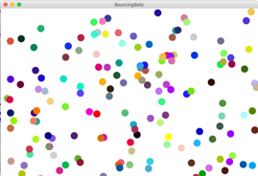
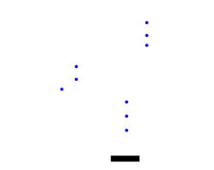

Final Project Example
Animate
Interact
On every animation:
Aliens move
Torpedos move
← Key pressed:
move ship left
→ Key pressed:
move ship right
Mouse pressed:
Add torpedo
Keyboard Karel
Bouncing Balls
Racing Cars
Rocket Paddle
Rocket Paddle
Find worked examples!!

Slide 5

Learning Goals
Understand chars and Strings
Write methods acting on Strings
Learn something interesting

Slide 6



Text Applications

Slide 7
How is text
represented?

Slide 8
The variable type String
Text is stored using the variable type String.
A String is a sequence of characters.
public void run() {
String text = "hello!";
println(text);
}
Notes:
Write code that reads in a line of text from the user and echoes it back. First, do “Nubian Ibex”

Slide 9
The variable type String
text
H
e
l
l
o
!
0
1
2
3
4
5
char c = text.charAt(index);
int len = text.length(); // 6
All characters in a string have an index.
You can access a character in the string via its index.
The length of a string is one larger than the last valid index in the string.

Slide 10

String Methods
public void run() {
String example = "Hi mom";
// example of length method
int length = example.length();
println(length); // prints 6
// example of getCharAt
char firstLetter = example.charAt(0);
println(firstLetter); // prints 'H'
// loop that prints letters one-by-one
for(int i = 0; i < example.length(); i++) {
char ch = example.charAt(i);
println(ch);
}
}
🤔
Notes:
Review the ourPrintln method, which prints one character at a time.

Slide 11
String Methods
public void run() {
String example = "Hi mom";
// example of length method
int length = example.length();
println(length); // prints 6
// example of getCharAt
char firstLetter = example.charAt(0);
println(firstLetter); // prints 'H'
// loop that prints letters one-by-one
for(int i = 0; i < example.length(); i++) {
char ch = example.charAt(i);
println(ch);
}
}
6
example
length
H
i
m
o
m
6
0
1
2
3
4
5

Slide 12
String Methods
public void run() {
String example = "Hi mom";
// example of length method
int length = example.length();
println(length); // prints 6
// example of getCharAt
char firstLetter = example.charAt(0);
println(firstLetter); // prints 'H'
// loop that prints letters one-by-one
for(int i = 0; i < example.length(); i++) {
char ch = example.charAt(i);
println(ch);
}
}
6
H
example
first Letter
length
H
i
m
o
m
6
'H'
0
1
2
3
4
5

Slide 13
String Methods
public void run() {
String example = "Hi mom";
// example of length method
int length = example.length();
println(length); // prints 6
// example of getCharAt
char firstLetter = example.charAt(0);
println(firstLetter); // prints 'H'
// loop that prints letters one-by-one
for(int i = 0; i < example.length(); i++) {
char ch = example.charAt(i);
println(ch);
}
}
6
H
H
example
first Letter
length
i
ch
H
i
m
o
m
6
'H'
0
'H'
0
1
2
3
4
5

Slide 14
String Methods
public void run() {
String example = "Hi mom";
// example of length method
int length = example.length();
println(length); // prints 6
// example of getCharAt
char firstLetter = example.charAt(0);
println(firstLetter); // prints 'H'
// loop that prints letters one-by-one
for(int i = 0; i < example.length(); i++) {
char ch = example.charAt(i);
println(ch);
}
}
6
H
H
i
example
first Letter
length
i
ch
H
i
m
o
m
6
'H'
1
'i'
0
1
2
3
4
5

Slide 15
String Methods
public void run() {
String example = "Hi mom";
// example of length method
int length = example.length();
println(length); // prints 6
// example of getCharAt
char firstLetter = example.charAt(0);
println(firstLetter); // prints 'H'
// loop that prints letters one-by-one
for(int i = 0; i < example.length(); i++) {
char ch = example.charAt(i);
println(ch);
}
}
6
H
H
i
example
first Letter
length
i
ch
H
i
m
o
m
6
'H'
2
' '
0
1
2
3
4
5

Slide 16
String Methods
public void run() {
String example = "Hi mom";
// example of length method
int length = example.length();
println(length); // prints 6
// example of getCharAt
char firstLetter = example.charAt(0);
println(firstLetter); // prints 'H'
// loop that prints letters one-by-one
for(int i = 0; i < example.length(); i++) {
char ch = example.charAt(i);
println(ch);
}
}
6
H
H
i
m
example
first Letter
length
i
ch
H
i
m
o
m
6
'H'
3
'm'
0
1
2
3
4
5

Slide 17
String Methods
public void run() {
String example = "Hi mom";
// example of length method
int length = example.length();
println(length); // prints 6
// example of getCharAt
char firstLetter = example.charAt(0);
println(firstLetter); // prints 'H'
// loop that prints letters one-by-one
for(int i = 0; i < example.length(); i++) {
char ch = example.charAt(i);
println(ch);
}
}
6
H
H
i
m
o
example
first Letter
length
i
ch
H
i
m
o
m
6
'H'
4
'o'
0
1
2
3
4
5

Slide 18
String Methods
public void run() {
String example = "Hi mom";
// example of length method
int length = example.length();
println(length); // prints 6
// example of getCharAt
char firstLetter = example.charAt(0);
println(firstLetter); // prints 'H'
// loop that prints letters one-by-one
for(int i = 0; i < example.length(); i++) {
char ch = example.charAt(i);
println(ch);
}
}
6
H
H
i
m
o
m
example
first Letter
length
i
ch
H
i
m
o
m
6
'H'
5
'm'
0
1
2
3
4
5

Slide 19
String Methods
public void run() {
String example = "Hi mom";
// example of length method
int length = example.length();
println(length); // prints 6
// example of getCharAt
char firstLetter = example.charAt(0);
println(firstLetter); // prints 'H'
// loop that prints letters one-by-one
for(int i = 0; i < example.length(); i++) {
char ch = example.charAt(i);
println(ch);
}
}
6
H
H
i
m
o
m
example
first Letter
length
i
H
i
m
o
m
6
'H'
6
0
1
2
3
4
5

Slide 20
How are characters
represented?

Slide 21
The variable type char
The primitive type char represents a single character or glyph.
Some examples:
char letterA = 'A';
char plus = '+';
char zero = '0';
char space = ' ';
char newLine = '\n'; // special
char first = text.charAt(0);

Slide 22
ASCII
* This is only the first half of the table
The letter A, for example, has the ASCII value 65
Using portions of slides by Eric Roberts

Slide 23
‘A’ -> ‘Z’ are sequential.
‘a’ -> ‘z’ are sequential.
‘0’ -> ‘9’ are sequential.

Slide 24
Useful Character methods
public void run() {
String str = readLine("Line: ");
char ch = str.charAt(0);
println("Original first char: " + ch);
ch = Character.toUpperCase(ch);
println("Uppercase first char: " + ch);
if (Character.isLetter(ch)) {
println("It’s a letter!");
}
}

Slide 25

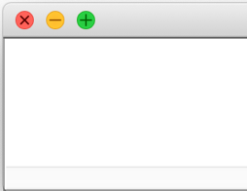

Useful Character Methods
char ch = 'a';
Character.toUpperCase(ch);
println(ch);
c
a
A
a
char ch = 'a’;
ch = Character.toUpperCase(ch);
println(ch);
A
c
a
A
A
Notes:
Write code that reads in a line of text from the user and echoes it back. First, do “Nubian Ibex”

Slide 26
Useful Character methods
static boolean isDigit(char ch)
Determines if the specified character is a digit.
static boolean isLetter(char ch)
Determines if the specified character is a letter.
static boolean isLetterOrDigit(char ch)
Determines if the specified character is a letter or a digit.
static boolean isLowerCase(char ch)
Determines if the specified character is a lowercase letter.
static boolean isUpperCase(char ch)
Determines if the specified character is an uppercase letter.
static boolean isWhitespace(char ch)
Determines if the specified character is whitespace (spaces and tabs).
static char toLowerCase(char ch)
Converts ch to its lowercase equivalent, if any. If not, ch is returned unchanged.
static char toUpperCase(char ch)
Converts ch to its uppercase equivalent, if any. If not, ch is returned unchanged.
Using portions of slides by Eric Roberts

Slide 27
Strings have some unique properties

Slide 28
Strings are Immutable
Java strings are immutable: once a string has been created you cannot set characters.
To change a string:
Create a new string holding the new value you want it to have via concatenation (+).
Reassigning the String variable (that’s allowed).
Important consequence: if you pass a String into a method, that method cannot modify that string.
Notes:
Show off toUpperCase and toLowerCase. Show that they don't actually modify the string because strings are immutable.

Slide 29

Strings are often made through concatenation
public void run() {
String s1 = "Breakout";
String s2 = "it was awesome";
String s3 = "I crushed " + s1 + " and " + s2;
println(s3);
}
s1
"Breakout"
s2
"it was awesome"
s3
"I crushed Breakout and it was awesome"
I crushed Breakout and it was awesome
Notes:
This is not all that new

Slide 30
Reversing a String
Many string algorithms use the “loop and construct” pattern.

Slide 31
Reversing a String
H
e
l
l
o
!

Slide 32
Reversing a String
H
e
l
l
o
!
H

Slide 33
Reversing a String
H
e
l
l
o
!
e
H

Slide 34
Reversing a String
H
e
l
l
o
!
l
e
H

Slide 35
Reversing a String
H
e
l
l
o
!
l
l
e
H

Slide 36
Reversing a String
H
e
l
l
o
!
o
l
l
e
H

Slide 37
Reversing a String
H
e
l
l
o
!
!
o
l
l
e
H

Slide 38

reverseString
public void run() {
println("This program reverses a string.");
String str = readLine("Enter a string: ");
String rev = reverseString(str);
println(str + " spelled backwards is " + rev);
}
rev
str
STRESSED
ReverseString
This program reverses a string.
STRESSED
Enter a string:
Using portions of slides by Eric Roberts
skip simulation

Slide 39
reverseString
public void run() {
println("This program reverses a string.");
String str = readLine("Enter a string: ");
String rev = reverseString(str);
println(str + " spelled backwards is " + rev);
}
private String reverseString(String str) {
String result = "";
for ( int i = 0; i < str.length(); i++ ) {
result = str.charAt(i) + result;
}
return result;
}
rev
str
DESSERTS
STRESSED
result
str
i
5
7
8
2
3
4
6
0
S
STRESSED
1
TS
RTS
ERTS
SERTS
SSERTS
ESSERTS
DESSERTS
ReverseString
This program reverses a string.
STRESSED
Enter a string:
Using portions of slides by Eric Roberts
skip simulation

Slide 40
reverseString
public void run() {
println("This program reverses a string.");
String str = readLine("Enter a string: ");
String rev = reverseString(str);
println(str + " spelled backwards is " + rev);
}
rev
str
DESSERTS
STRESSED
ReverseString
This program reverses a string.
STRESSED
Enter a string:
STRESSED spelled backwards is DESSERTS
Using portions of slides by Eric Roberts
skip simulation

Slide 41
Useful String methods
int length()
Returns the length of the string
char charAt(int index)
Returns the character at the specified index. Note: Strings indexed starting at 0.
String substring(int p1, int p2)
Returns the substring beginning at p1 and extending up to but not including p2
String substring(int p1)
Returns substring beginning at p1 and extending through end of string.
boolean equals(String s2)
Returns true if string s2 is equal to the receiver string. This is case sensitive.
int compareTo(String s2)
Returns integer whose sign indicates how strings compare in lexicographic order
int indexOf(char ch) or int indexOf(String s)
Returns index of first occurrence of the character or the string, or -1 if not found
String toLowerCase() or String toUpperCase()
Returns a lowercase or uppercase version of the receiver string
Using portions of slides by Eric Roberts

Slide 42
Palindrome
A palindrome is a string that reads the same forwards and backwards.
For example:
Abba
Racecar
Kayak
Mr. Owl ate my metal worm.
Go hang a salami! I'm a lasagna hog.
Elu par cette crapule
How would we use reverseString() to check if a word is a palindrome?
private String reverseString(String str) {
String result = "";
for ( int i = 0; i < str.length(); i++ ) {
result = str.charAt(i) + result;
}
return result;
}
🤔

Slide 43
Let’s Code it!

Slide 44
Equality
private boolean isPalindrome(String original) {
String reversed = reverseString(original);
return reversed == original;
}
private boolean isPalindrome(String original) {
String reversed = reverseString(original);
return reversed.equals(original);
}
Use str1.equals(str2) to compare strings, not str1 == str2

Slide 45
Some test cases
Let's test our program on some examples:
racecar
kayak
mr. owl ate my metal worm.
go hang a salami! i'm a lasagna hog.
Will it work?
private boolean isPalindrome(String original) {
String reversed = reverseString(original);
return reversed.equals(original);
}
Notes:
This isn't going to work. Why not? Go to the board – are these strings really equal to their reverses?
Need to convert to lower case, for starters. Then, need to strip out everything besides letters.

Slide 46
More Palindromes
Here are some palindromes in other languages:
بلح تعلق تحت قلعة حلب (Dates hang underneath a castle in Halab)
여보, 안경 안보여 (Honey, I can't see my glasses)
कड़क (a loud thunderous sound)
上海自來水來自海上 (Shanghai tap water originates from "above" the ocean)
The comedian Dmitri Martin also has a routine about palindromes; check it out at https://www.youtube.com/watch?v=0hUHDIOazIU

Slide 47
Stress Test
A man, a plan, a caret, a ban, a myriad, a sum, a lac, a liar, a hoop, a pint, a catalpa, a gas, an oil, a bird, a yell, a vat, a caw, a pax, a wag, a tax, a nay, a ram, a cap, a yam, a gay, a tsar, a wall, a car, a luger, a ward, a bin, a woman, a vassal, a wolf, a tuna, a nit, a pall, a fret, a watt, a bay, a daub, a tan, a cab, a datum, a gall, a hat, a tag, a zap, a say, a jaw, a lay, a wet, a gallop, a tug, a trot, a trap, a tram, a torr, a caper, a top, a tonk, a toll, a ball, a fair, a sax, a minim, a tenor, a bass, a passer, a capital, a rut, an amen, a ted, a cabal, a tang, a sun, an ass, a maw, a sag, a jam, a dam, a sub, a salt, an axon, a sail, an ad, a wadi, a radian, a room, a rood, a rip, a tad, a pariah, a revel, a reel, a reed, a pool, a plug, a pin, a peek, a parabola, a dog, a pat, a cud, a nu, a fan, a pal, a rum, a nod, an eta, a lag, an eel, a batik, a mug, a mot, a nap, a maxim, a mood, a leek, a grub, a gob, a gel, a drab, a citadel, a total, a cedar, a tap, a gag, a rat, a manor, a bar, a gal, a cola, a pap, a yaw, a tab, a raj, a gab, a nag, a pagan, a bag, a jar, a bat, a way, a papa, a local, a gar, a baron, a mat, a rag, a gap, a tar, a decal, a tot, a led, a tic, a bard, a leg, a bog, a burg, a keel, a doom, a mix, a map, an atom, a gum, a kit, a baleen, a gala, a ten, a don, a mural, a pan, a faun, a ducat, a pagoda, a lob, a rap, a keep, a nip, a gulp, a loop, a deer, a leer, a lever, a hair, a pad, a tapir, a door, a moor, an aid, a raid, a wad, an alias, an ox, an atlas, a bus, a madam, a jag, a saw, a mass, an anus, a gnat, a lab, a cadet, an em, a natural, a tip, a caress, a pass, a baronet, a minimax, a sari, a fall, a ballot, a knot, a pot, a rep, a carrot, a mart, a part, a tort, a gut, a poll, a gateway, a law, a jay, a sap, a zag, a tat, a hall, a gamut, a dab, a can, a tabu, a day, a batt, a waterfall, a patina, a nut, a flow, a lass, a van, a mow, a nib, a draw, a regular, a call, a war, a stay, a gam, a yap, a cam, a ray, an ax, a tag, a wax, a paw, a cat, a valley, a drib, a lion, a saga, a plat, a catnip, a pooh, a rail, a calamus, a dairyman, a bater, a canal – Panama!
Notes:
Try this in our checker – it should work!

Slide 48
Useful String methods

Slide 49
Useful String Methods
String original = "How now brown cow";
// replace all occurrences of " " with "!"
String replaced = original.replaceAll(" ", "!");
println(replaced);
// returns true if original contains the string "cow"
println(original.contains("cow"));
// String → String[], split on spaces " "
String[] strArray = original.split(" ");
for(int i = 0; i < strArray.length; i++) {
println(strArray[i]);
}
// String[] → String, joined by ”@"
String concatenated = String.join("@", strArray);
println(concatenated); // How@now@brown@cow
"How!now!brown!cow"
true
{"How","now",
"brown","cow"}
"How@now@brown@cow"

Slide 50
The Caesar Cipher
Julius Caesar
Jül Sezar

Slide 51
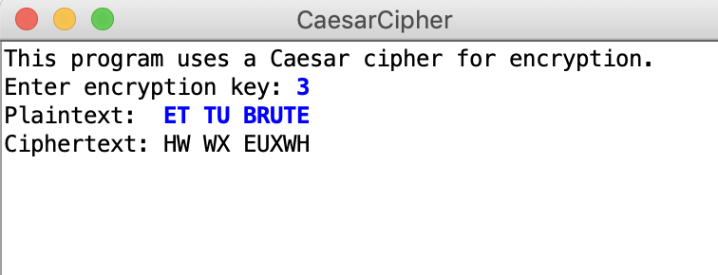
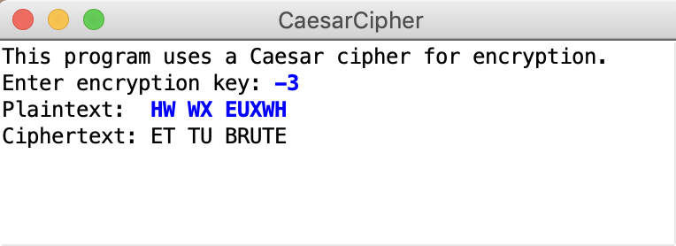
The Caesar Cipher
Encrypt: shift by key=3
Decrypt: shift by key=-3
English alphabet
(26 letters)
ABCDEFGHIJKLMNOPQRSTUVWXYZ
🤔

Slide 52
How the cipher works
ASCII uppercase:
65 66 67 68 69 70 … 87 88 89 90
A B C D E F … W X Y Z
Cipher key=3
Shifted by key=3
68 69 70 71 72 73 … 90 65 66 67
D E F G H I … Z A B C
char c = 'A';
char shiftC = c + 3;
println("plain : " + c);
println("cipher: " + shiftC);
Type mismatch: cannot convert from int to char

Slide 53
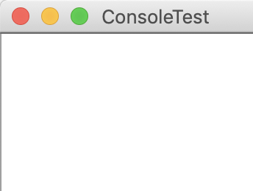
How the cipher works
ASCII uppercase:
65 66 67 68 69 70 … 87 88 89 90
A B C D E F … W X Y Z
Cipher key=3
Shifted by key=3
68 69 70 71 72 73 … 90 65 66 67
D E F G H I … Z A B C
char ch = 'A';
int chIntShift = (int) ch + key;
char chShift = (char) chIntShift;
println("plain: " + ch);
println("ASCII: " + (int) ch);
println("cipher: " + chShift);
plain: A
ASCII: 65
cipher: D

Slide 54
How the cipher works
ASCII uppercase:
65 66 67 68 69 70 … 87 88 89 90
A B C D E F … W X Y Z
Cipher key=3
Shifted by key=3
68 69 70 71 72 73 … 90 65 66 67
D E F G H I … Z A B C
char ch = 'Y';
char chShift = (char) (ch + key);
println("plain: " + ch);
println("ASCII: " + (int) ch);
println("cipher: " + chShift);
plain: Y
ASCII: 89
cipher: \
ASCII 92
🤔

Slide 55
How the cipher works
ASCII uppercase:
65 66 67 68 69 70 … 87 88 89 90
A B C D E F … W X Y Z
Cipher key=3
Shifted by key=3
68 69 70 71 72 73 … 90 65 66 67
D E F G H I … Z A B C
char ch = 'Y';
int chInt = (int) ch;
int chIntShift = ch + key;
if(chIntShift > 90) { chIntShift -= 26; }
char chShift = (char) chIntShift;
println("plain : " + ch);
println("ASCII: " + chInt);
println("cipher: " + chShift);
plain: Y
ASCII: 89
cipher: B
ASCII
66: 92-26

Slide 56
How the cipher works
%
I’m Modulo!
Remember me?
int chIntShift = 'A' + (ch - 'A' + key) % 26;
char chShift = (char) chIntShift;
'Y' - 'A’ = 89 – 65= 24
'Y' - 'A' + key = 24 + 3 = 27
('Y' - 'A' + key) % 26 = 1
'A' + ('Y' - 'A' + key) % 26 = 66
ASCII uppercase:
65 66 67 68 69 70 71 … 88 89 90
A B C D E F G … X Y Z

Slide 57
Allowing all ASCII symbols
ASCII uppercase:
65 66 67 68 69 70 71 … 88 89 90
A B C D E F G … X Y Z
ASCII lowercase:
97 98 99 100 101 102 103 … 120 121 122
a b c d e f g … x y z
if (Character.isUpperCase(ch)) {
// shift by key
// ensure resulting ASCII is between 65 and 90
} else if (Character.isLowerCase(ch)) {
// shift by key
// ensure resulting ASCII is between 97 and 122
} else {
// do nothing
}

Slide 58
Your goals today
(1) Array exercise: MinMaxMean (+ ArrayList exercises) Submit by end of Lab 2, even if you are not finished
(2) Final Project (start by Lab 3)
Console/Graphics,
Games/Stories,
Puzzles/Adventures,
Math/Medicine/Science,
…The ArrayList goes on!

Slide 59
Computer Science isn’t just about programming.

Slide 60
What String actually is
=
String str
str.length();
str.charAt(i);
str.split(str);
str.contains(str);
char[] charArray
➕
Data storage
Useful methods
Why do both of these exist in the Java language?
char[] builds off Java’s fundamental data storage
String is a library built on top of an array

Slide 61
CS is about algorithms and structures
=
ArrayList<Grect> list
GRect[] grectArray
Data storage
list.size();
list.get(i);
list.add(i, value);
list.remove(i);
➕
Useful methods
How does this work?
➕
resizable

Slide 62

CS is about algorithms and structures
ArrayList<String> sentence = new ArrayList<String>();
sentence
char[] arr = {};

Slide 63
CS is about algorithms and structures
ArrayList<String> sentence = new ArrayList<String>();
sentence.add("H");
sentence
char[] arr = {};

